Slide 1
Adopting Blockchain In The Digital Music Industry
By: Pablo Blanco &
Andi Maroge

Slide 2
How technical innovation empowers artist in the digital music industry

Slide 3
Outlining issues

Slide 4
Is blockchain the solution?

Slide 5




How Blockchain Works
Blockchain was first introduced in 2008, it’s the technology BitCoin (Decentralized currency) was built on
Blockchain is a distributed ledger that keeps track of ownership of digital assets
Blockchain is a specific type of distributed ledger
Blockchain uses cryptographic signatures to store data

Slide 6



How Blockchain Works cont.
Data Location is Decentralized
Each transaction is posted in a shared ledger
Shared ledger spans across thousands of computers around the World

Slide 7
How Blockchain Works cont.
Shared Ledger stores a digital fingerprint of an accomplished asset.
A block is created every 10 minutes. It contains data of all previous transactions.
Each block is linked to previous blocks.
Each block is time-stamped.

Slide 8
Current State of Blockchain
Multiple Platforms available today:
Choon
Bittunes
Peertracks
Musicoin
Voise
Some built their own systems while others use already existing ones.

Slide 9
Musicoin Example
Musicoin
Uses blockchain to allow consumers to stream favorite music from artists
It’s a free platform
Uses it’s own cryptocurrency
It’s in early stages

Slide 10
Choon Example
Choon
Allows artists to release music with digital signatures
Digital signatures are used to identify piece of music to artists
Study: 52% of consumers want to use alternative streaming service
31% believed it’s not right to not pay artists fairly

Slide 11


Potential Issues with Blockchain
1. Complex
2. Low Perceived Value
People don’t fully understand it
Companies business models is people believe need artists need fair pay
Companies are not giving out enough information for consumers
Perceived value of cryptocurrency is low
Cryptocurrency may go up or down
Distribution of music becomes an issue

Slide 12
cont.
3. Resistance of Intermediaries
Blockchain promotes removing intermediaries
Intermediaries have more influence over industry
Transparency is artist’s main complaint about third parties
4. Attribution of Work
Major problem for artists
Computer algorithms solve problem through hashing content

Slide 13
Is Blockchain the Solution?
Blockchain technology has very high potential in the music industry
Allows attribution of music to artist
Great for supporting artists
Decentralization increases security
Costs are reduced to minimum
Early efforts were not major, but there is potential

Slide 14
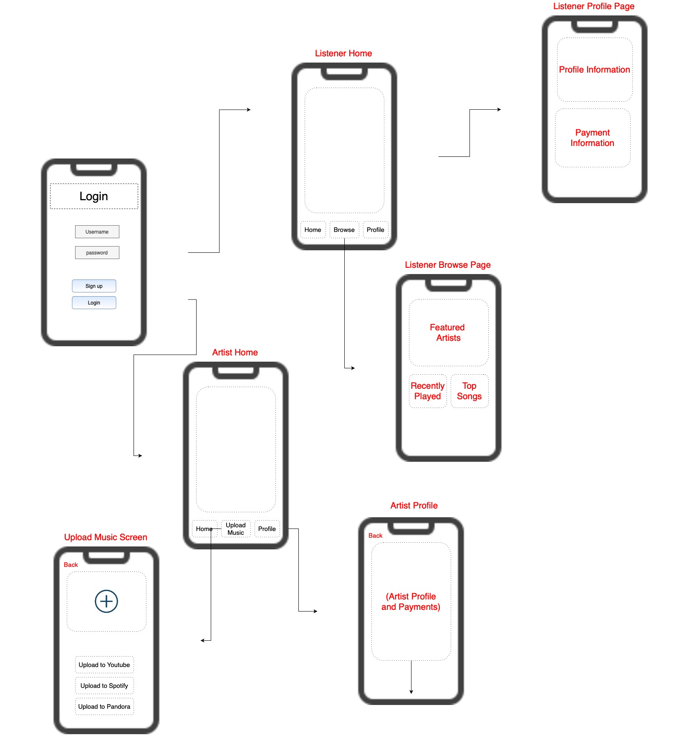
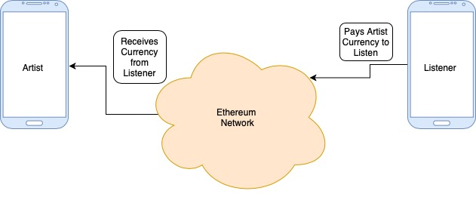
The Solution
User Interface of
App
Build a reliable mobile application
Software application allows artists to upload their music
Artists will receive payment from fanbase(users)
Software application uses the Ethereum blockchain network
Ethereum Network

Slide 15




Future Works of Blockchain
Blockchain is highly regarded. Endless possibilities
Several companies are already using blockchain in the Music Industry
Independent content creation becoming a trend
Blockchain will be applied in the Music Industry as well as others

Slide 16
Thank you

